Slide 1


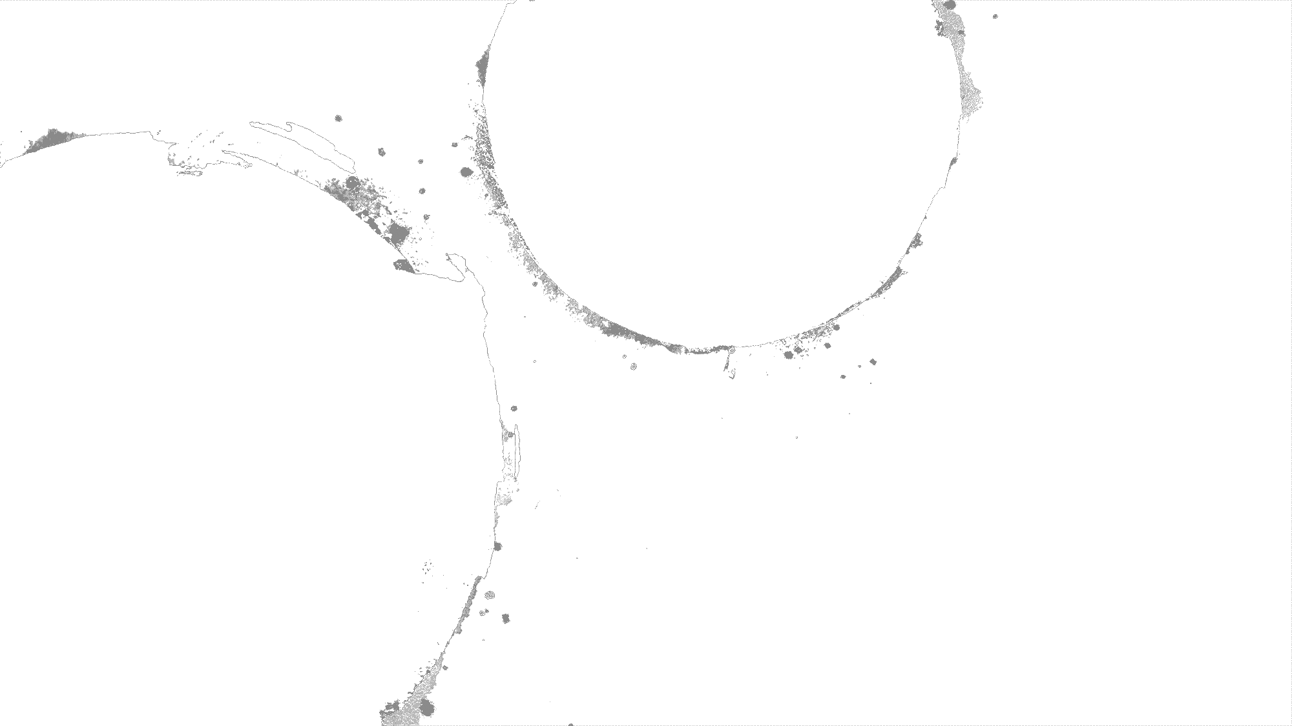
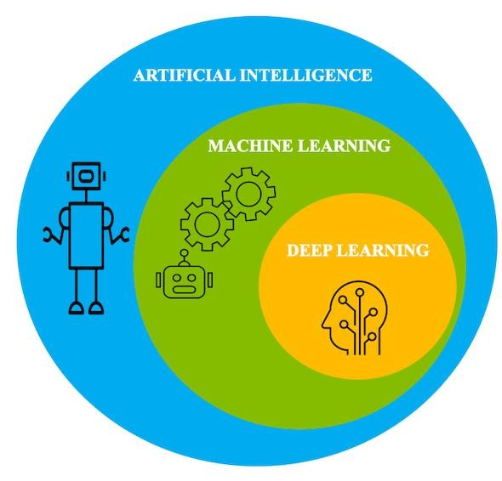


Lambton College
School of Computer Studies
AML-3104 Neural Networks
and Deep Learning

Slide 2
Deep
Neural Networks
Convolutional
Neural
Networks
1

Slide 3
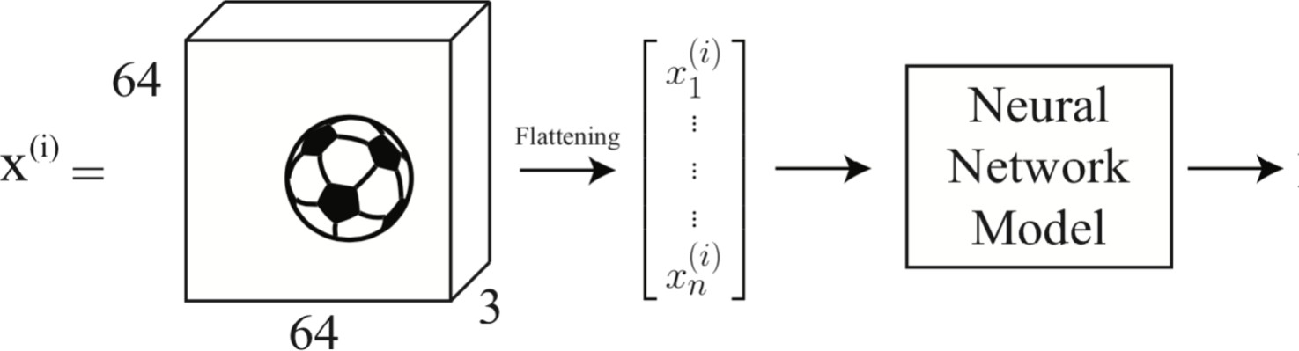

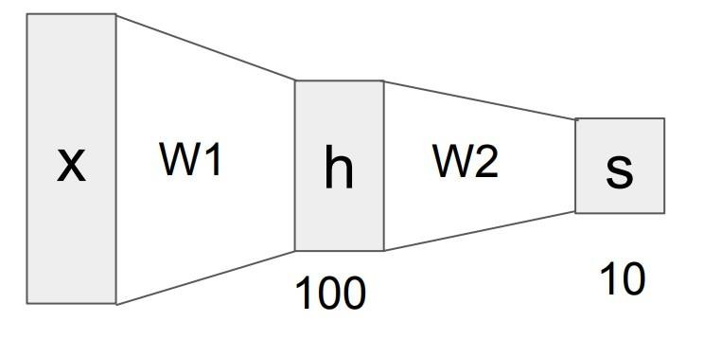



What
we
have
learned
so
far?
𝑖
��T��(𝐱 )
Last layer is just:
Linear regression
𝑖
Logistic regression,
Softmax regression
��T��(𝐱 )
^{��(𝐱 𝑖 )}
𝑖
��T��(𝐱 )

Slide 4
What we have learned so
We must apply nonlinear activation. For hidden layers, often
far?
● ReLU: 𝑎
𝑥 = max{0, ��}
● Hyperbolic tangent: 𝑎
𝑥
=
tanh(��)
For output layers, often
● Linear (identity): 𝑎
𝑥
=
𝑥
● Sigmoid: 𝑎
𝑥
1
=
1+exp(−��)
● Softmax: ��(��)
=
ex p ( 𝑥 𝑖 )
∑j
ex p ( 𝑥 j )

Slide 5
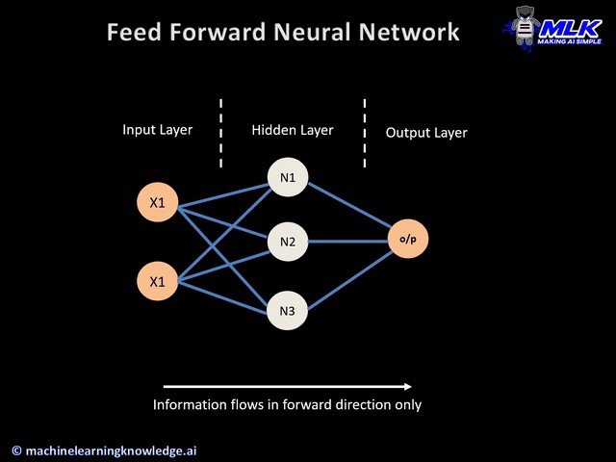
What we have learned so far?
We can learn the parameters using backpropagation:
●
●
Forward pass: calculates the output of the NN and
loss
Backward
pass:
updates
the
parameters
of
the
NN
Animation from: https://machinelearningknowledge.ai/animated-explanation-of-feed-forward-neural-network-architecture/

Slide 6
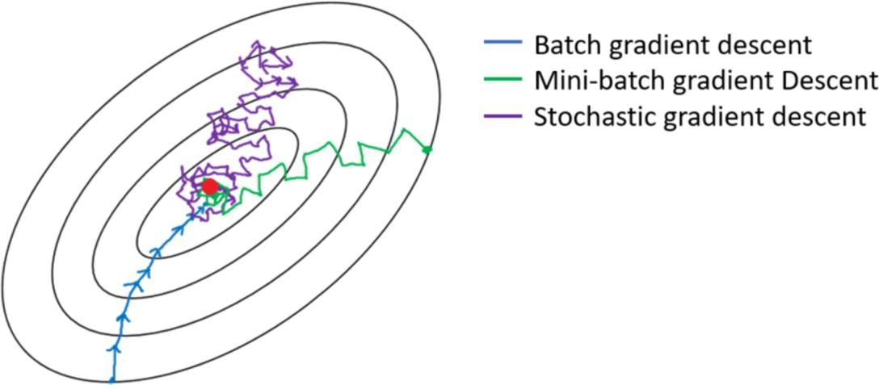
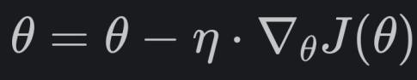
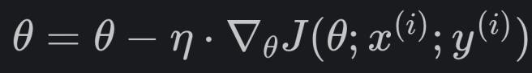
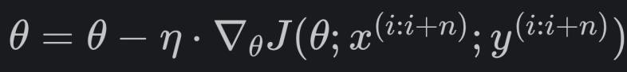
How do we learn?
Batch Gradient Descent:
•
•
Expensive to compute gradient for large dataset
Computational and space complexity high
Stochastic Gradient Descent:
•
Lots of random motion (slow to converge)
Mini-batch Gradient Descent (Mini-batch of size
n):
•
Hybrid between the two, still stochastic but less random

Slide 7

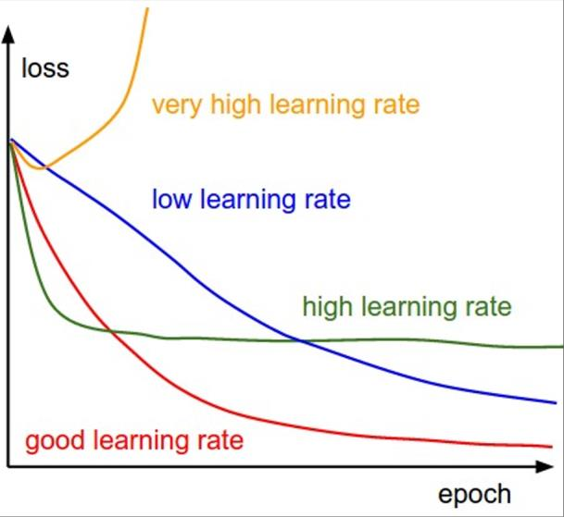
How do we learn?
Stochastic Gradient Descent:
Mini-batch Gradient Descent (Mini-batch
of size
n):
There are better variants of (mini-batch) SGD:
●
●
●
●
●
Momentum: Gradient + Momentum
Nestrov: Momentum + Gradients
Adagrad: Normalize with sum of sq
RMSprop: Normalize with moving avg of sum of
ADAM: RMsprop + momentum (most popular)
squares
See this link for more details: https://ruder.io/optimizing-gradient-descent/

Slide 8
Universal Approximator Theorem
●
One/two hidden layer is enough to represent (not learn) an
approximation of any function to an arbitrary degree of accuracy
●
So why use deep neural nets?
○ Shallow net may need (exponentially) more width to improve accuracy
○ Shallow net may overfit more

Slide 9
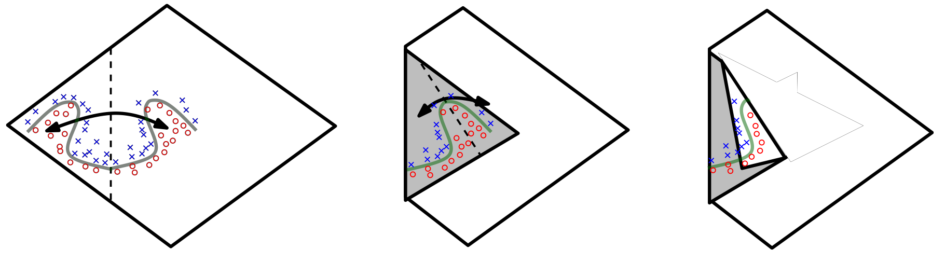
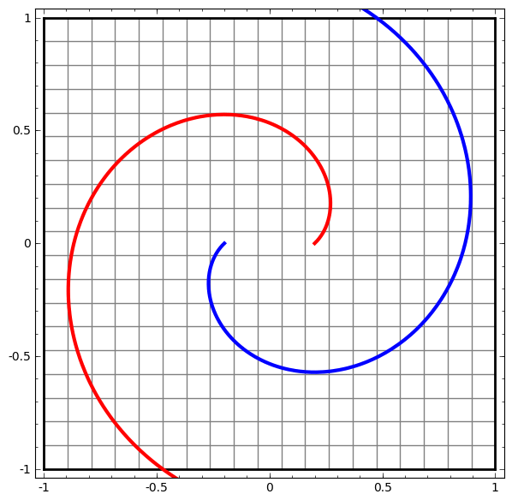
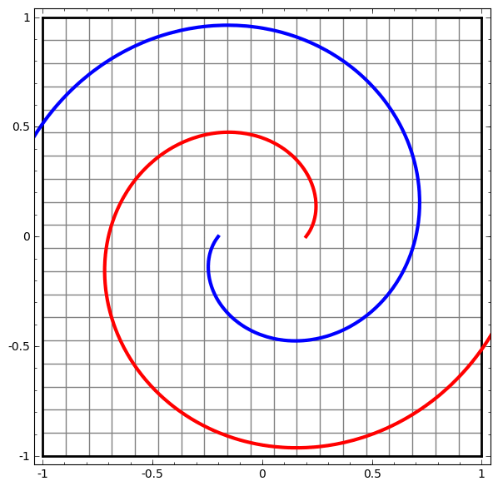
Exponential
Representation
Advantage
of
Depth
Animation from: http://colah.github.io/posts/2014-03-NN-Manifolds-Topology/

Slide 10
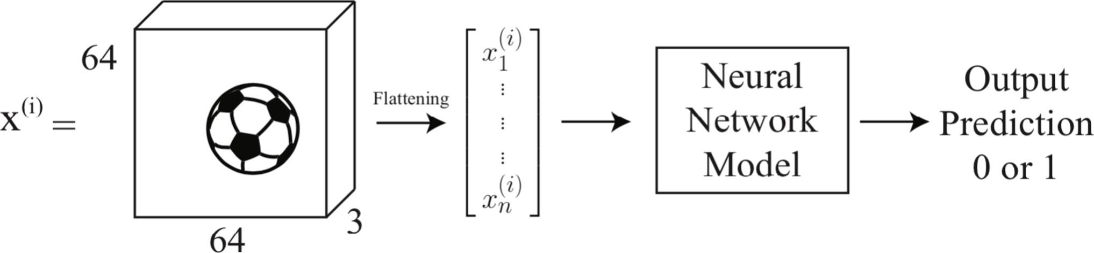
Limitations of Multi-Layer Perceptron (MLP)
●
●
●
Does not exploit the order and local relations in
the
data!
Large number of parameters
in
deep
networks
May
not
generalize
well
64x64x3=12288 parameters

Slide 11
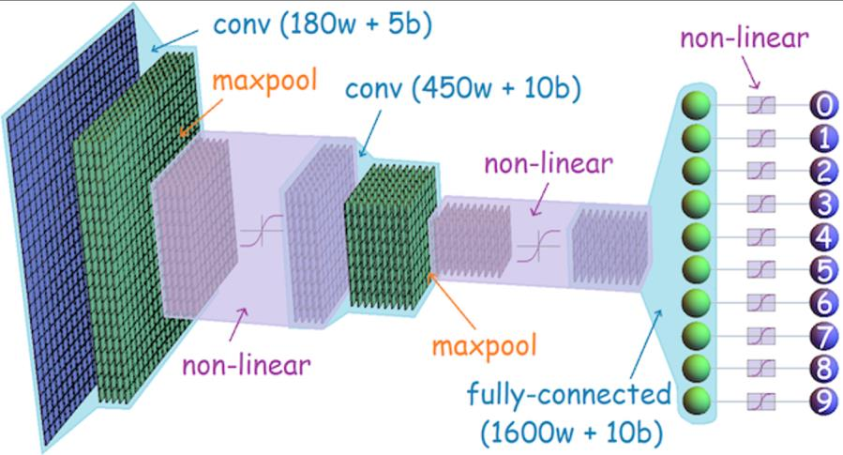
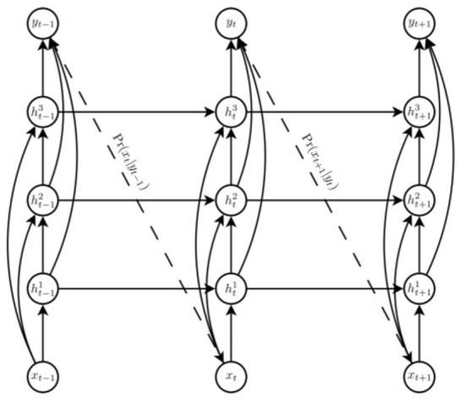
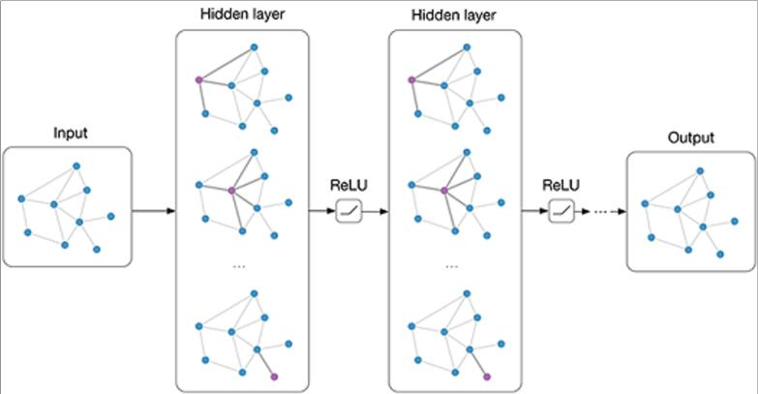
What are
some
specialized
deep learning
models?
Convolutional
Recurrent or
Transformer NNs
NN
(Images)
(Time
Series)
Graph NN
(Networks/Relational)

Slide 12
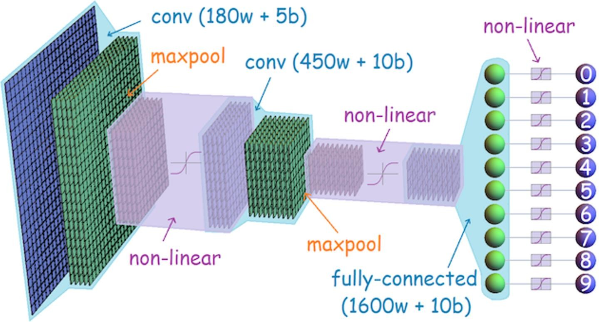
What
are
some
specialized
deep
learning
models?
Convolutional
Neural Network

Slide 13

Fully Connected Layer
32x32x3 image
->
stretch
to
3072
x
1
input
activation
1
1
10 x 3072
weights
3072
10

Slide 14
Fully Connected Layer
32x32x3 image
->
stretch
to
3072
x
1
input
activation
1
1
10 x 3072
weights
3072
10
1 number:
the result of taking a dot between a row of W and
product
the input
(a 3072-dimensional dot product)

Slide 15
Convolution Layer
32x32x3
image ->
preserve
spatial
structure
32
height
32
depth
width
3

Slide 16
Convolution Layer
32x32x3
image
5x5x3
filter
32
Convolve the filter with the image
i.e. “slide over the image spatially,
computing dot products”
32
3

Slide 17
Convolution Layer
Filters always extend the full
depth
of
the
input
volume
32x32x3
image
5x5x3
filter
32
Convolve the filter with
the image
i.e. “slide over the image spatially,
computing dot products”
32
3

Slide 18
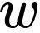
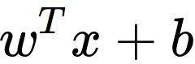
Convolution
Layer
32x32x3 image
5x5x3 filter
32
1 number:
the result of
taking
a dot product between the
filter and a small 5x5x3 chunk of the image
(i.e. 5*5*3 = 75-dimensional dot product + bias)
32
3

Slide 19
Convolution
Layer
32
32
3

Slide 20
Convolution
Layer
32
32
3

Slide 21
Convolution
Layer
32
32
3

Slide 22
Convolution
Layer
32
32
3

Slide 23
Convolution
Layer
activation map
32x32x3 image
5x5x3 filter
32
28
convolve (slide)
spatial locations
over all
32
28
3
1

Slide 24
consider a second,
green filter
Convolution
Layer
32x32x3 image
5x5x3 filter
activation
maps
32
28
convolve (slide)
spatial locations
over all
32
28
3
1

Slide 25
For
example,
if
we had
6
5x5
filters,
we’ll
get
6
separate activation
maps:
activation
maps
32
28
Convolution
Layer
32
28
3
6
of size 28x28x6!
We stack these
up to get a “new image”

Slide 26
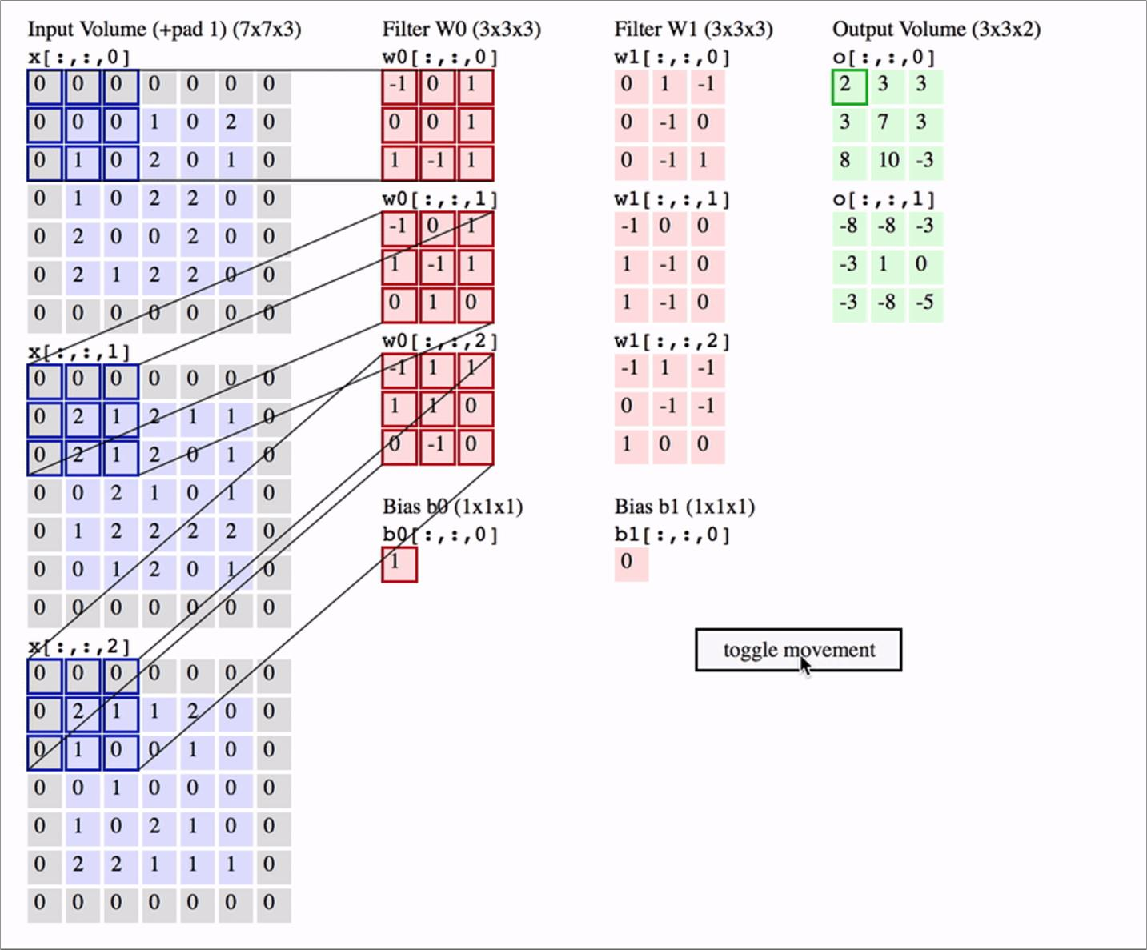
Another View

Slide 27
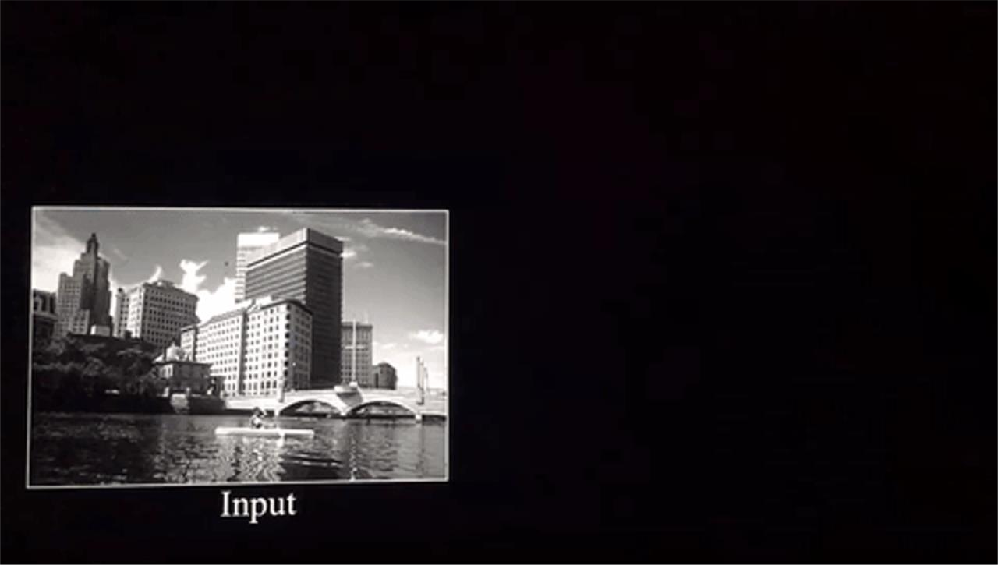
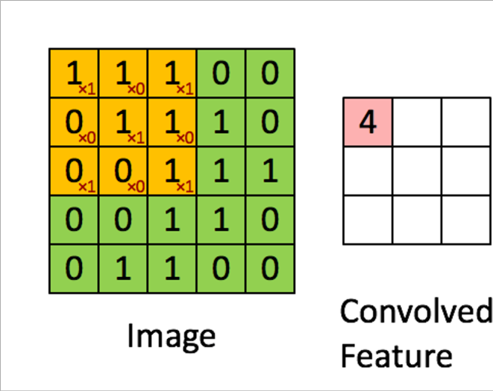
An example

Slide 28
Preview: ConvNet is
activation functions
a
sequence
of
Convolution
Layers,
interspersed with
32
28
CONV,
ReLU
e.g.
6
5x5x3
filters
32
28
3
6

Slide 29
Preview: ConvNet is
activation functions
a
sequence
of
Convolution
Layers,
interspersed with
32
28
24
….
CONV,
ReLU
CONV,
ReLU
e.g. 10
5x5x6
filters
CONV,
ReLU
e.g.
6
5x5x3
filters
32
28
24
3
6
10

Slide 30
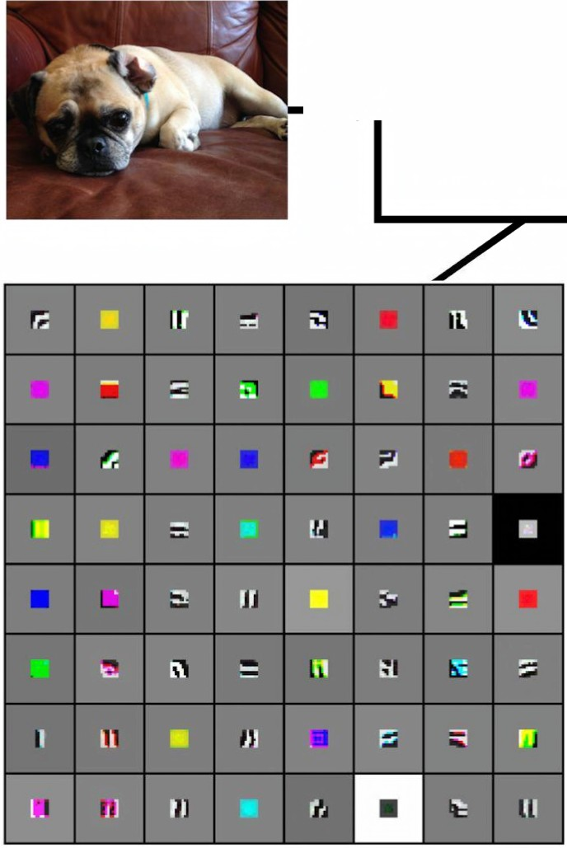
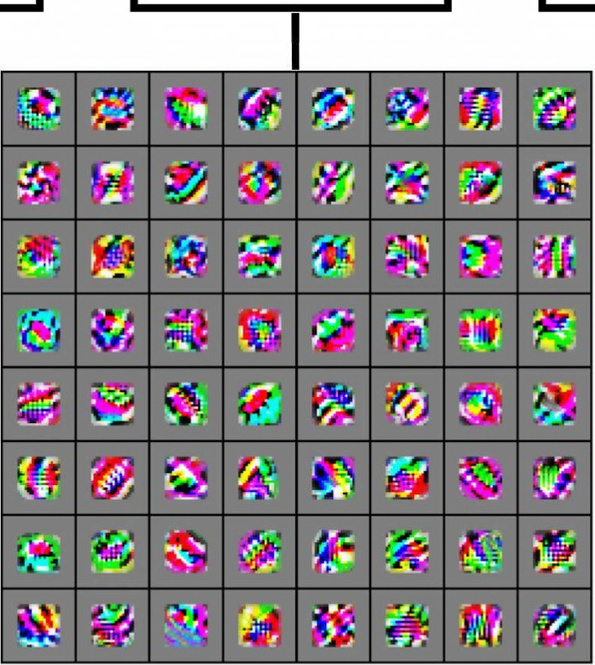
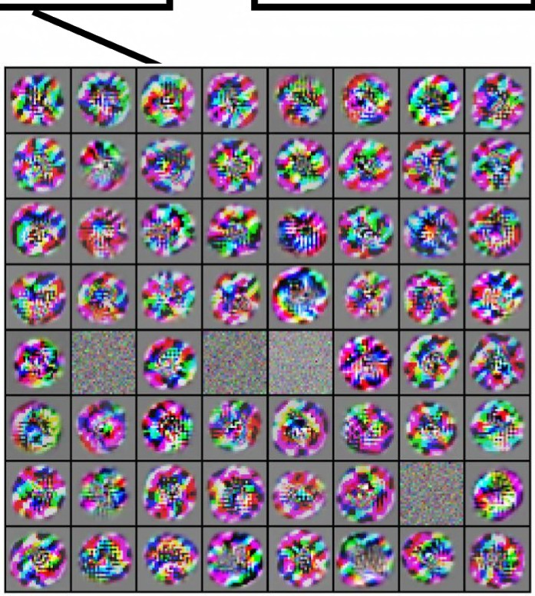
Preview
[Zeiler and Fergus 2013]
Visualization of VGG-16by Lane McIntosh. VGG-16
architecture from [Simonyanand Zisserman2014].
-... ^{Low-le}
featur
vel
es
Mid-level
features
features
Linearly
classifier
~
...,.. ...
Mid-level
High-level
...,.. ...
separable
VGG-16
Conv1
1
VGG-16 Conv3
2
VGG-16
Conv5
3

Slide 31
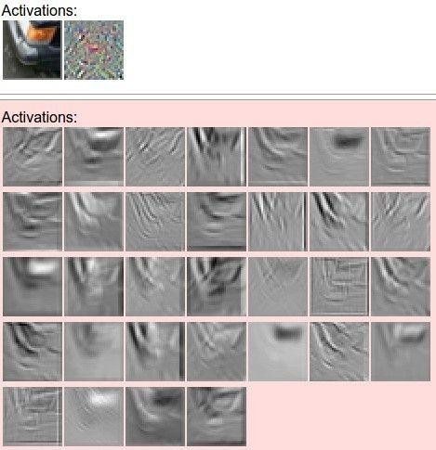
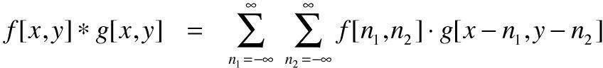
one filter =>
example 5x5 filters
(32 total)
one
activation map
We call the layer convolutional
because it is related to convolution
of
two
signals:
elementwise multiplication and sum of
a filter and the signal (image)
Figure copyright Andrej Karpathy.

Slide 32
A
closer
look
at spatial dimensions:
activation map
32x32x3 image
5x5x3 filter
32
28
convolve (slide)
spatial locations
over all
32
28
3
1

Slide 33
A
closer
look
at
spatial dimensions:
7
7x7 input (spatially)
assume 3x3 filter
7

Slide 34
A
closer
look
at
spatial dimensions:
7
7x7 input (spatially)
assume 3x3 filter
7

Slide 35
A
closer
look
at
spatial dimensions:
7
7x7 input (spatially)
assume 3x3 filter
7

Slide 36
A
closer
look
at
spatial dimensions:
7
7x7 input (spatially)
assume 3x3 filter
7

Slide 37
A
closer
look
at
spatial dimensions:
7
7x7 input (spatially)
assume 3x3 filter
=> 5x5 output
7

Slide 38
A
closer
look
at
spatial dimensions:
7
7x7 input (spatially)
assume 3x3 filter
applied with stride 2
7

Slide 39
A
closer
look
at
spatial dimensions:
7
7x7 input (spatially)
assume 3x3 filter
applied with stride 2
7

Slide 40
A
closer
look
at
spatial dimensions:
7
7x7 input (spatially)
assume 3x3 filter
applied with stride 2
=> 3x3 output!
7

Slide 41
A
closer
look
at
spatial dimensions:
7
7x7 input (spatially)
assume 3x3 filter
applied with stride 3?
7

Slide 42
A
closer
look
at
spatial dimensions:
7
7x7 input (spatially)
assume 3x3 filter
applied with stride 3?
7
doesn’t fit!
cannot apply 3x3 filter
7x7 input with stride 3.
on

Slide 43
N
Output size:
(N - F) / stride
+ 1
F
e.g. N = 7,
F =
3:
3)/1
F
N
stride
stride
stride
1
2
3
=>
=>
=>
(7
(7
(7
-
+
+
+
1
1
1
=
=
=
5
3
2.33 :\
- 3)/2
- 3)/3

Slide 44
In
practice:
Common to zero pad the border
0
0
0
0
0
0
e.g. input 7x7
3x3 filter, applied
0
with stride 1
0
pad
with
1
pixel
border =>
what
is
the
output?
0
0
(recall:)
(N - F) / stride + 1

Slide 45
In
practice:
Common to zero pad the border
0
0
0
0
0
0
e.g. input 7x7
3x3 filter, applied
pad with 1 pixel
0
with stride 1
0
border =>
what
is
the
output?
0
7x7
output!
0
(recall:)
(N + 2P - F) / stride
+ 1

Slide 46
In
practice:
Common to zero pad the border
0
0
0
0
0
0
e.g. input 7x7
3x3 filter, applied with stride 1 pad with 1 pixel border => what
0
0
is the output?
0
7x7 output!
in general, common to see CONV layers with stride 1, filters of size FxF, and zero-padding with (F-1)/2. (will preserve size spatially)
0
e.g. F
F F
=
=
=
3
5
7
=>
=>
=>
zero
zero zero
pad
pad pad
with
with with
1
2
3

Slide 47
Remember back to…
E.g. 32x32 input convolved repeatedly with 5x5 filters shrinks volumes
spatially!
(32
->
28
-> 24
...).
Shrinking
too
fast is
not
good,
doesn’t
work well.
32
28
24
….
CONV,
ReLU
CONV,
ReLU
e.g. 10
5x5x6
filters
CONV,
ReLU
e.g.
6
5x5x3
filters
32
28
24
3
6
10

Slide 48
Examples time:
Input volume: 32x32x3
10 5x5 filters with stride
1, pad 2
Output volume size: ?

Slide 49
Examples time:
Input volume: 32x32x3
10 5x5 filters with stride
1, pad 2
Output volume size:
(32+2*2-5)/1+1 = 32 spatially, so
32x32x10

Slide 50
Examples time:
Input volume: 32x32x3
10 5x5 filters with stride
1, pad 2
Number of parameters in this layer?

Slide 51
Examples time:
Input volume: 32x32x3
10 5x5 filters with stride 1, pad 2
Number of parameters in this layer?
each filter has 5*5*3 + 1 = 76 params
=> 76*10 = 760
(+1 for bias)

Slide 52
Convolution layer: summary
Let’s assume input is W₁ x H₁ x C Conv layer needs 4 hyperparameters:
-
-
-
-
Number of filters K
The
The
The
filter size F
stride S
zero padding P
This will produce an output
where:
of W2 x H2 x K
1
-
-
W2 = (W1 - F + 2P)/S +
H2 = (H1 - F + 2P)/S +
1
Number of parameters: F²CK and K biases

Slide 53
Convolution layer: summary
Common settings:
K =
-
-
-
-
(powers of 2, e.g. 32, 64, 128, 512
Let’s assume input is W
^{x H}₁ ^{x C}
1
F
F F F
=
=
=
=
3,
5,
5,
1,
S
S S S
=
=
=
=
1,
1,
2,
1,
P
P P P
= 1
= 2
= ?
Conv layer needs 4 hyperparameters:
-
-
-
-
Number of filters K
(whatever fits)
The
The
The
filter size F
stride S
zero padding P
=
0
This will produce an output
where:
of W2 x H2 x K
1
-
-
W2 = (W1 - F + 2P)/S +
H2 = (H1 - F + 2P)/S +
1
Number of parameters: F²CK and K biases

Slide 54
(btw,
1x1
convolution
layers make
perfect
sense)
1x1 CONV
with 32 filters
56
56
(each filter has size
1x1x64, and performs
a
64-dimensional
product)
dot
56
56
64
32

Slide 55
(btw,
1x1
convolution
layers make
perfect
sense)
1x1 CONV
with 32 filters
56
56
(each filter has size
1x1x64, and performs
a
64-dimensional
product)
dot
56
56
64
32

Slide 56
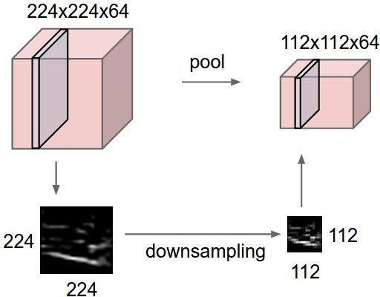
Pooling layer
-
-
makes the representations smaller and more manageable
operates over each activation map independently:

Slide 57
MAX
POOLING
Single
depth
slice
1
1
2
4
x
max pool with
2x2
filters
5
6
7
8
6
8
and
stride
2
3
2
1
0
3
4
1
2
3
4
y

Slide 58

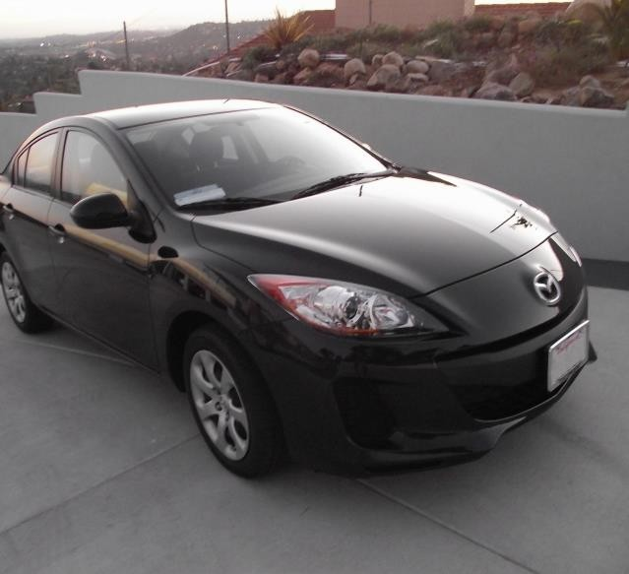
preview:

Slide 59
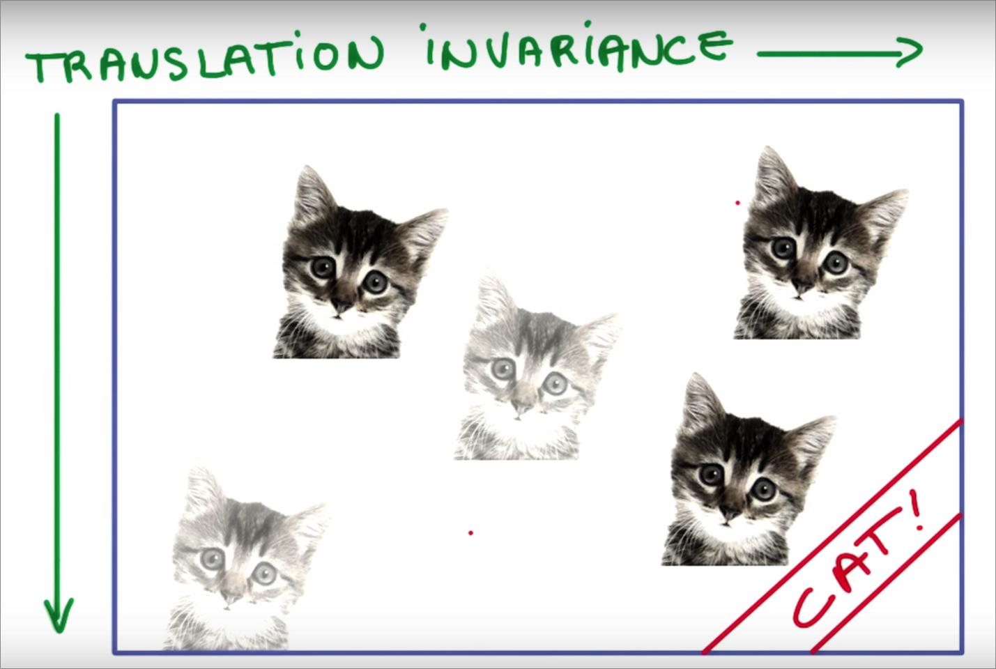
Properties of CNN: Translational
invariance
Since we are training filters to
detect cats and the moving
these filters over the data, a
differently positioned cat will
also get detected by the same
set of filters.

Slide 60
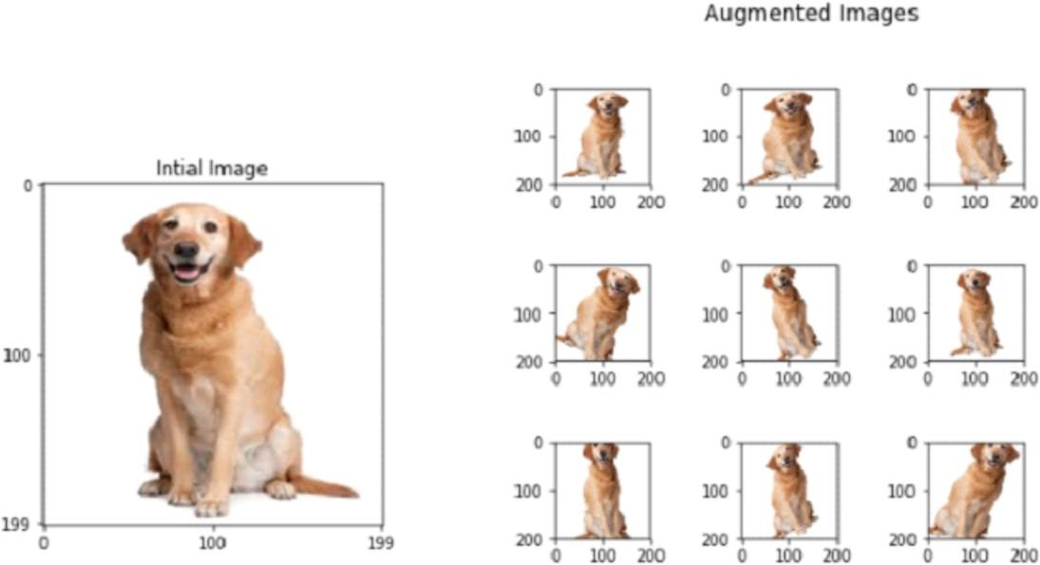
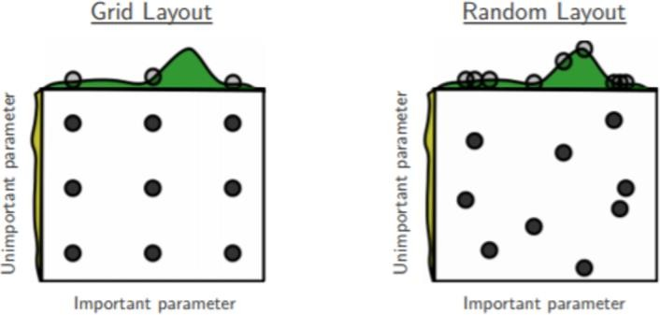
Tricks for training
Data augmentation if your data
smaller. This helps the network
generalize more.
set is
Early stopping if validation
improving.
Tune hyperparameters:
loss
stops
●
●
Random search
Grid search

Slide 61
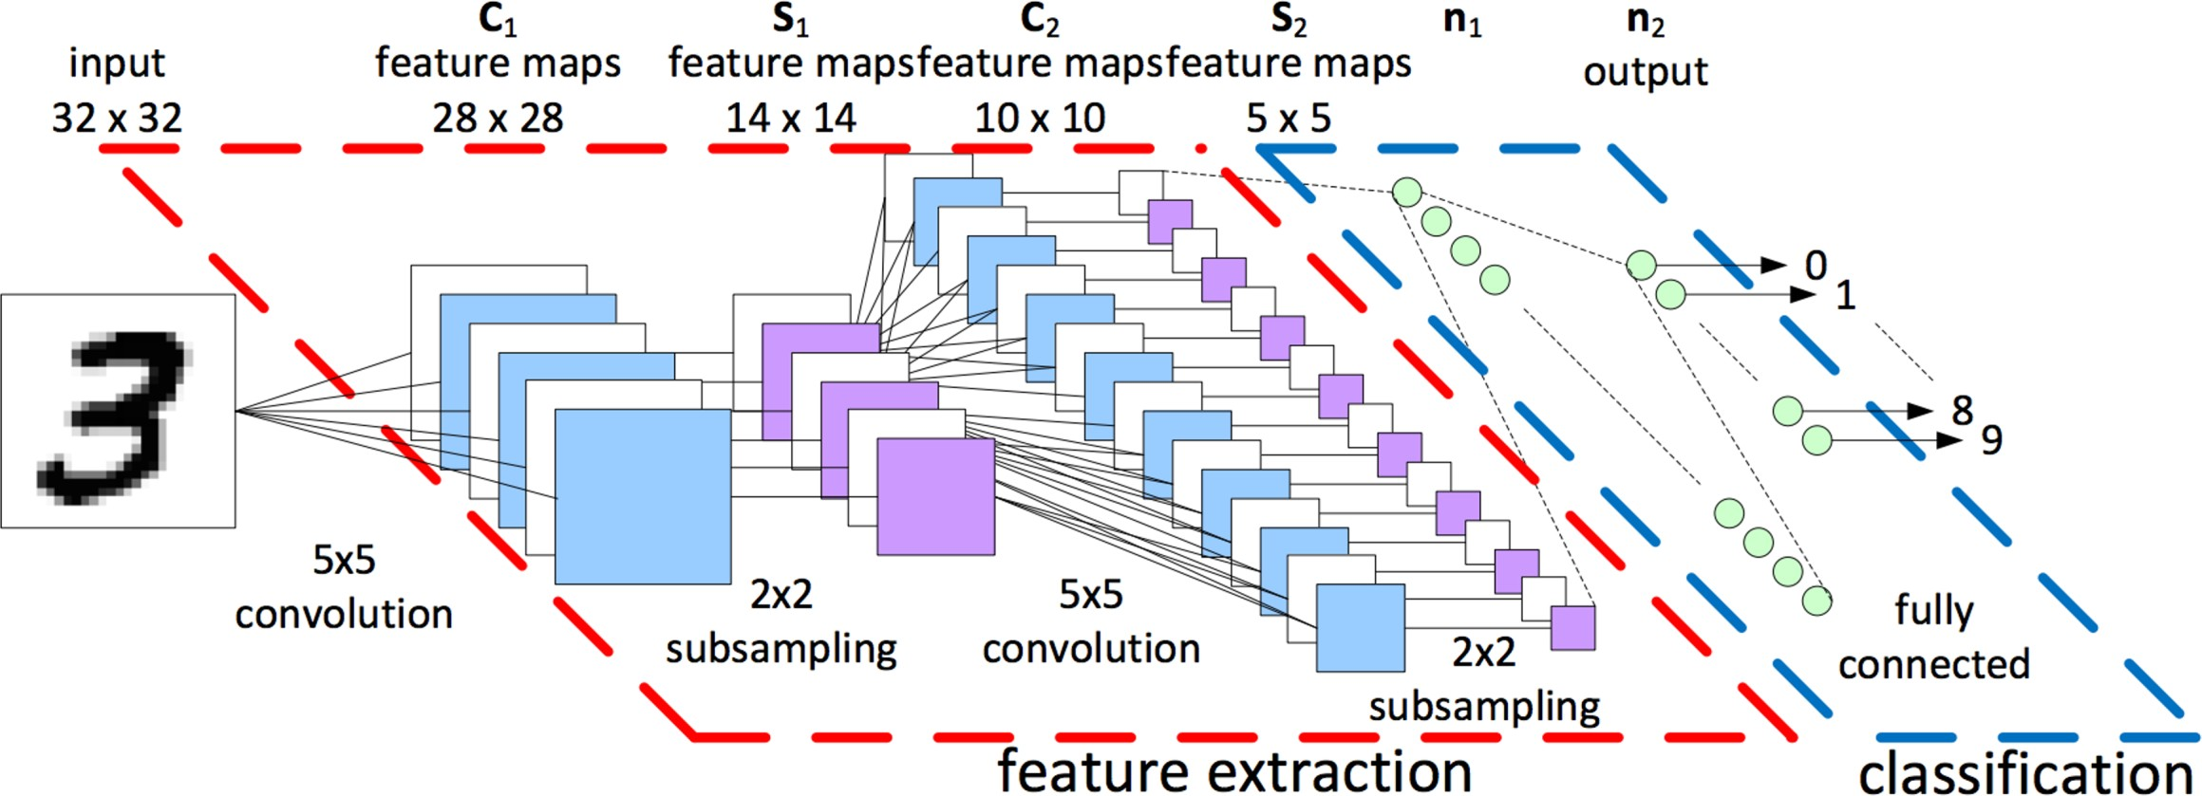
CNN:
Recap
Let convolutions extract features and let normal cnn’s decide on them.
Image credit: LeCun et al. (1998)

Slide 62
Summary
-
-
-
-
ConvNets stack CONV,POOL,FC layers
Trend towards smaller filters and deeper architectures
Trend towards getting rid of POOL/FC layers (just CONV)
Historically architectures looked like
[(CONV-RELU)*N-POOL?]*M-(FC-RELU)*K,SOFTMAX
where N is usually up to ~5, M is large, 0 <= K <= 2.
-
but recent advances such as ResNet/GoogLeNet
have challenged this paradigm

